Slide 1
What is MRI and How Does it Work?
Parimal Joshi, Peder Larson, Bochun (Marcus) Mei, Yanlin Zhu
Department of Radiology and Biomedical Imaging
University of California – San Francisco

Slide 2
But first, Introductions
Name
Educational Background
How we got into working on MRI
What are we trying to do with MRI

Slide 3
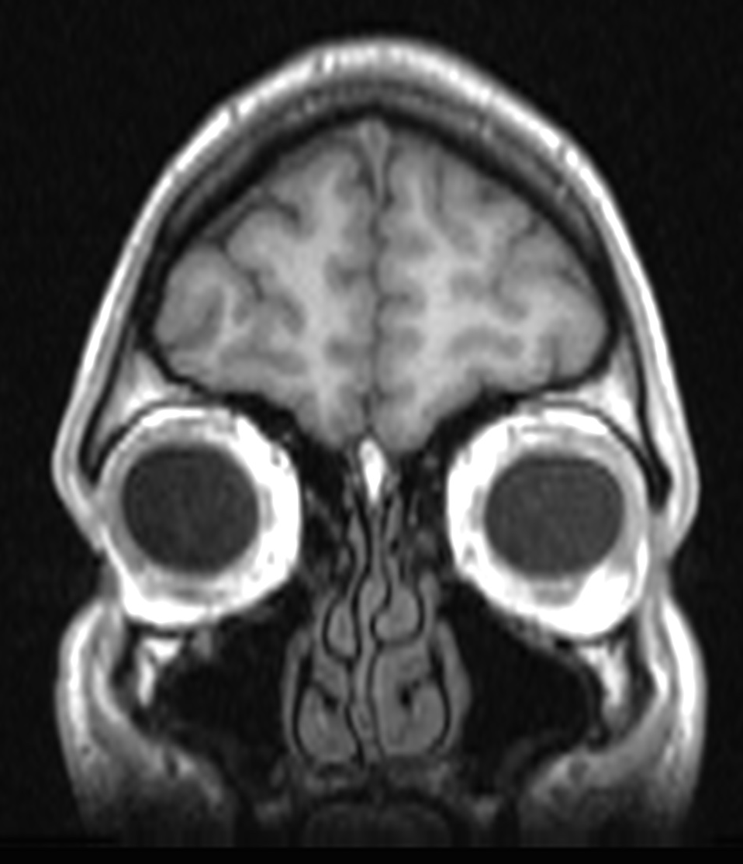
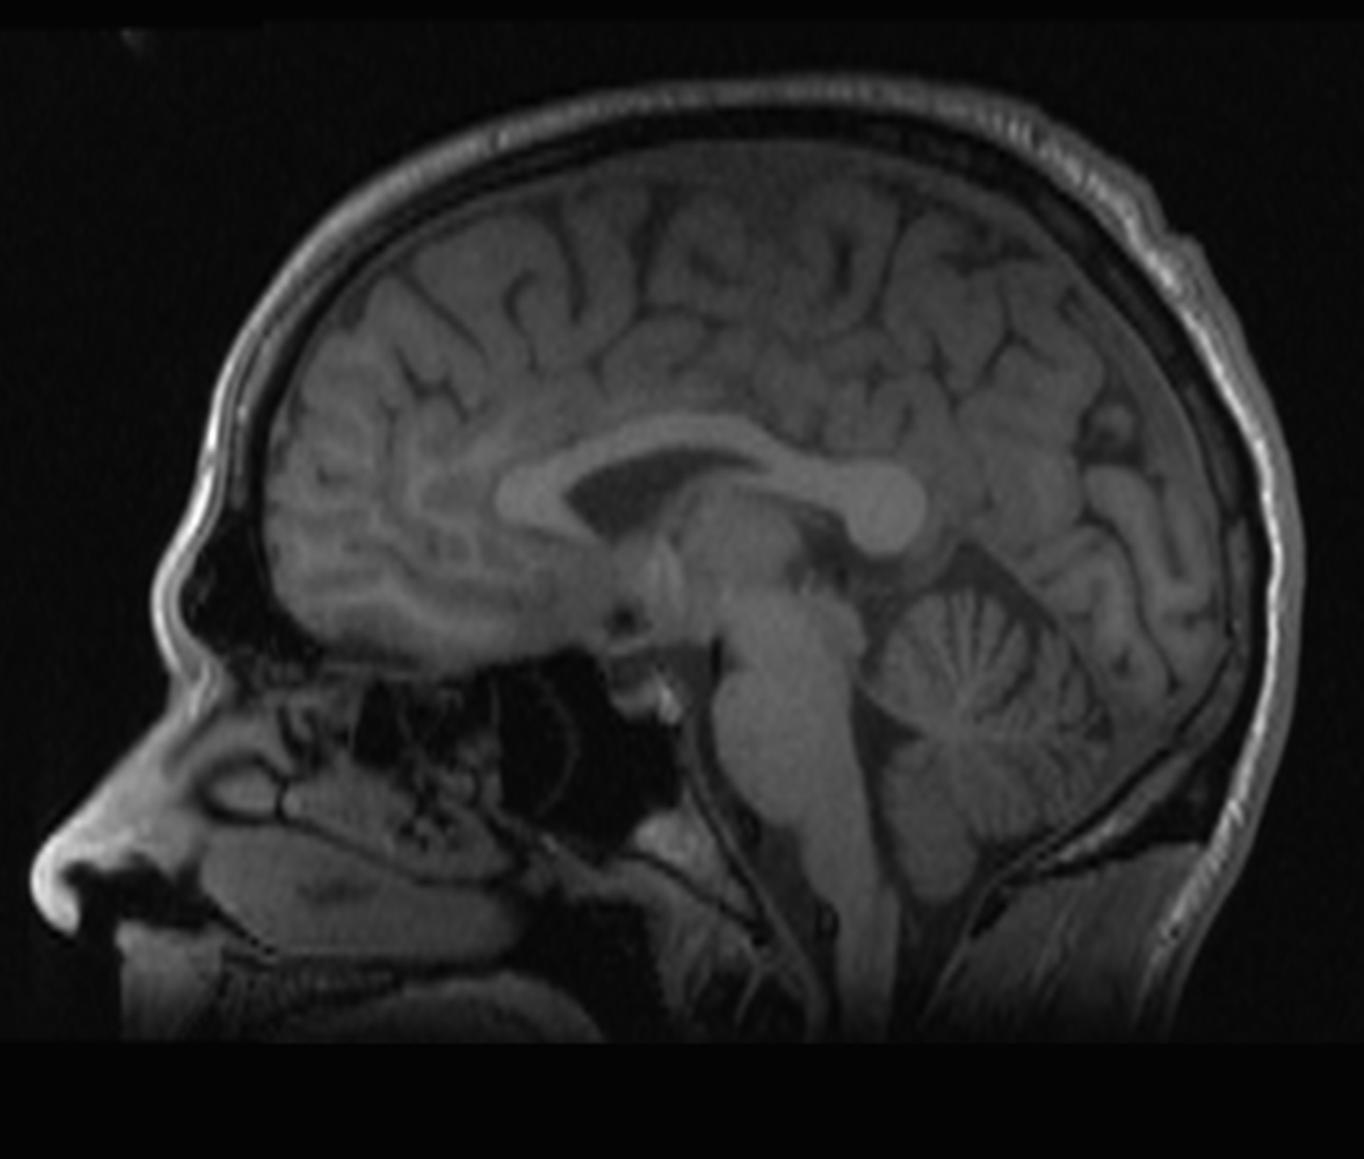
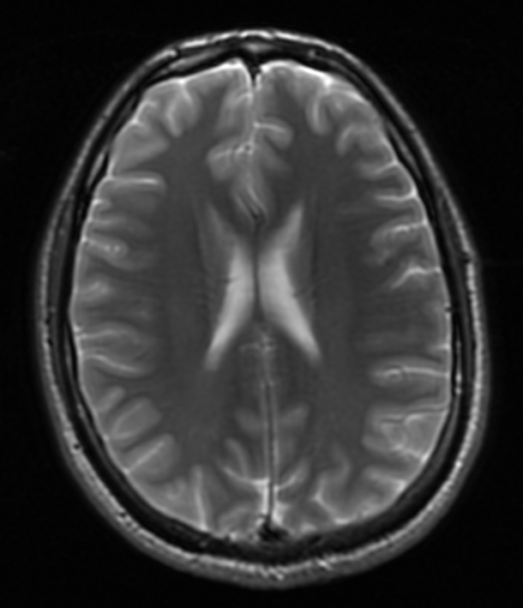
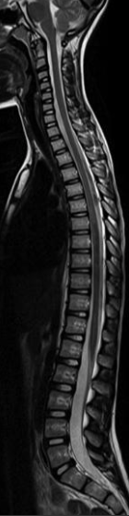
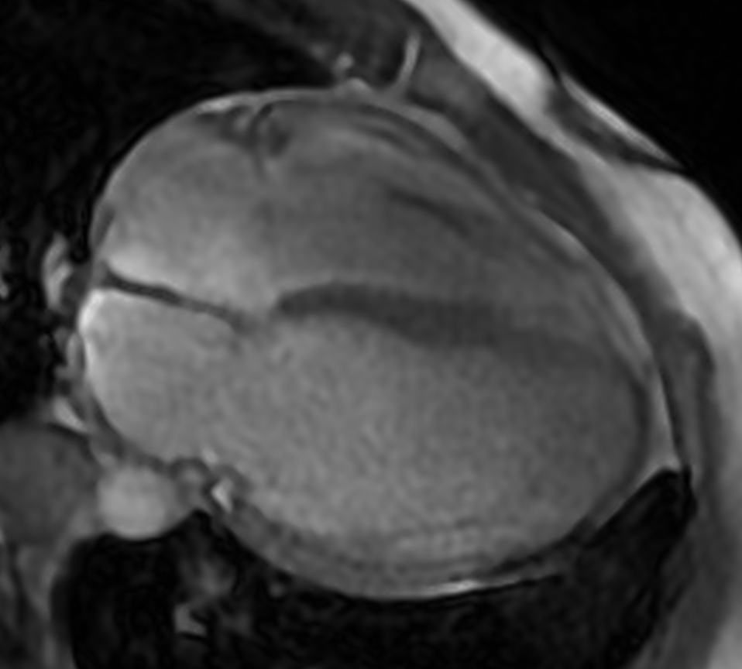
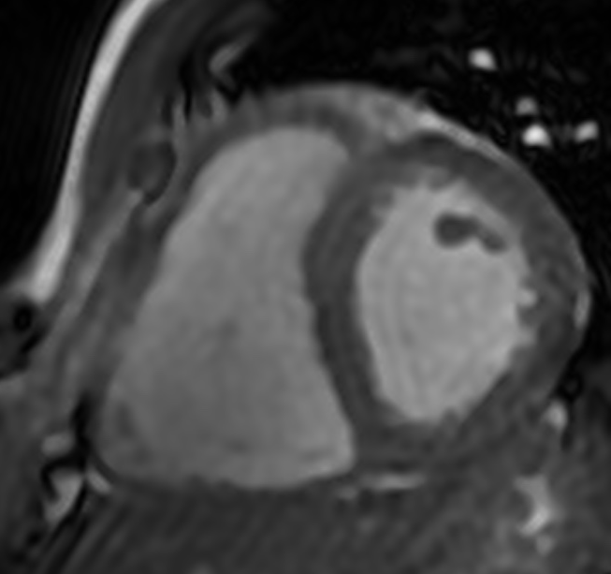
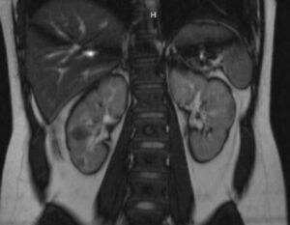
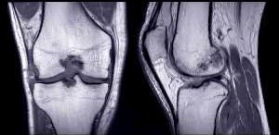
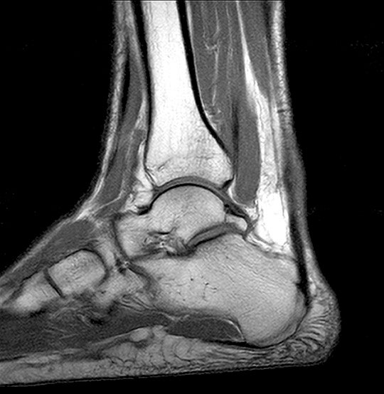
Magnetic Resonance Imaging (MRI)
MRI uses a powerful magnet and radio waves to take pictures inside of the body
MRI
  Magnetic – uses a very large
  magnetic field, and maps magnetic
  properties
  Resonance – hydrogen atoms
  vibrate at a radio frequency
  Imaging – pictures are created

Slide 4
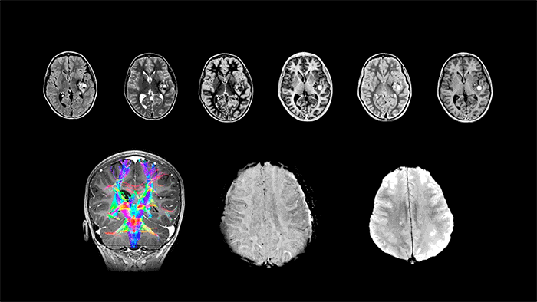
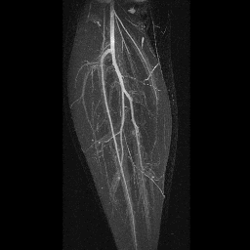
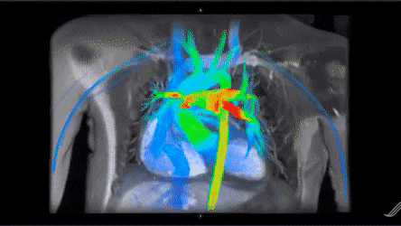
What does MRI measure?
Water molecules in the body
Your body is 80% water
Magnetic properties of water change between blood and different organs
  Creates “contrast” between structures
  Can also map brain activity, blood flow, and tissue mechanics

Slide 5
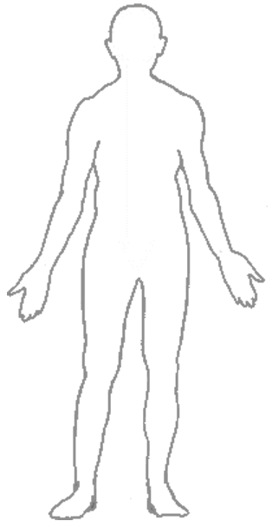

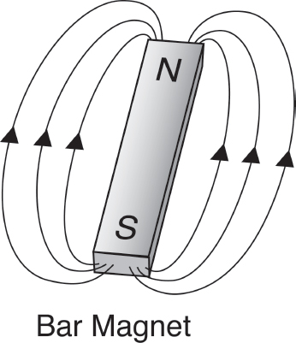


Where does the signal come from in MRI?
The signal in MRI comes from hydrogen atoms (¹H), primarily in water molecules (H₂O)
Hydrogen nuclei have a net “spin” (quantum physics phenomena)
  ¹H act like tiny magnets
  They can create a magnetic field and interact with external magnetic fields
μ – magnetic moment
≈
¹H
Spinning charged particle
“Spin”

Slide 6
Demo #1: Signal from Water
Water – signal
Air – no signal
Plastic lego?
Berries (demo later)
  Fruit – lots of water
  Seed – does it have water?

Slide 7
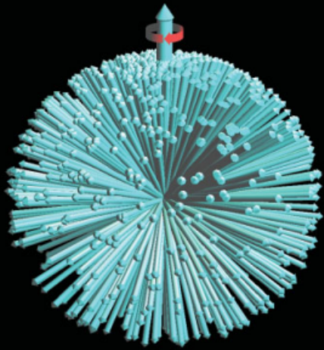
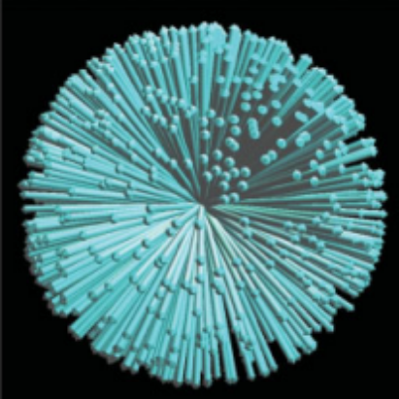
The Magnet
In the absence of a magnetic field, ¹H nuclear spins are randomly aligned
But, they have a slight preference to align with an external magnetic field, which we call “Polarization”
Because this is only a slight preference, we need very large magnets
B₀
No Magnetic Field: ¹H spins are randomly aligned
External Magnetic Field: ¹H spins slightly aligned
Notes:
Detecting signal from 0.001% of 1H nuclei

Slide 8
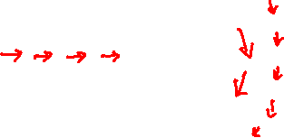
Magnets and Magnetic Fields
Tesla – unit of magnetic field
10⁴ G = 1 T
Earth’s magnetic field is ~0.05 mT (varies throughout the world)
Refrigerator Magnet ~ 1 mT
MRI Magnet ~ 3 T
Magnetic fields can be created via permanent magnets (e.g. refrigerator) or electromagnets by passing current through wires

Slide 9
Demo #2: Electromagnetic Motor
Battery creates current in loops of wire
Loops of wire produce magnetic field
Permanent magnetic repels magnetic field from wire, causing rotation

Slide 10
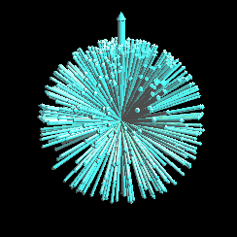
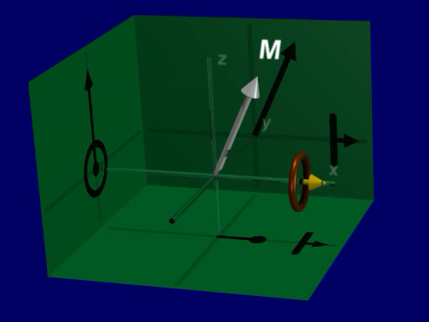
Resonance
B₀
¹H nuclear spins rotate in the presence of a magnetic field, which we call “Resonance”
This rotation creates signal for MRI
  A rotating magnet creates a fluctuating magnetic field
  Fluctuations in magnetic fields can be easily measured because they will create electric currents in an antenna, the “RF Coil”
Resonance occurs at a very specific rate, or frequency
“RF Coil” – an antenna

Slide 11
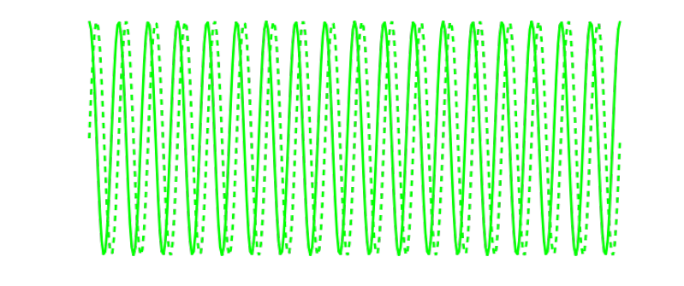
Resonance Excitation
If we just go into a magnet, there will be no measurable MRI signal
To get signal, we must “Excite” the ¹H nuclei
  Send a radio-frequency (RF) wave into the body
  (Frequencies around 100 MHz, similar to FM radio)
  This excitation allows the ¹H to rotate and create radio-frequency waves that we can measure – the MRI signal
B₀

Slide 12
Demo #3: Resonance
What does MRI signal look like?
  Look at the frequency (oscillations)
  Look at the amplitude (height)
We can adjust the frequency of our measurement
We can change the power of our radiofrequency waves
Notes:
Shift frequencies
Change power

Slide 13
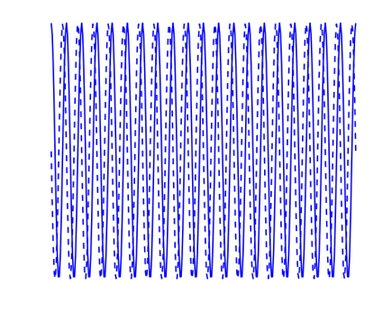
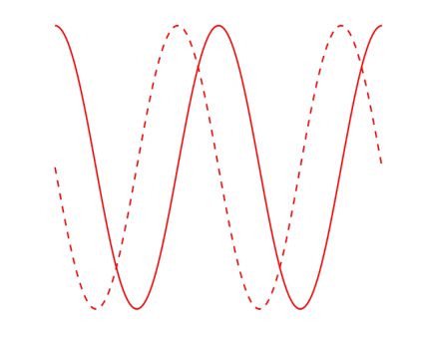
What about Imaging?
So far, all ¹H atoms are rotating at the same frequency
This is because the frequency is proportional to the magnetic field
To image, the magnetic field is varied across the body, creating a “gradient”
Different locations rotate at different frequencies
Different frequencies in the MRI signal are separated to create an image!

Slide 14
Demo #4: Imaging
Frequencies and Imaging
2D (slice) imaging
3D (volume) imaging

Slide 15
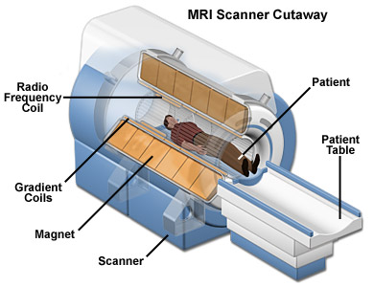
The MRI System
Magnet: polarize (align) ¹H spins in a large magnetic field
Radio-frequency (RF) coils (antennas)
  Send radio-frequency waves to excite spins
  Receive radio-frequency waves from rotating spins
Gradient coils: vary the magnetic field across the body to create an image

Slide 16
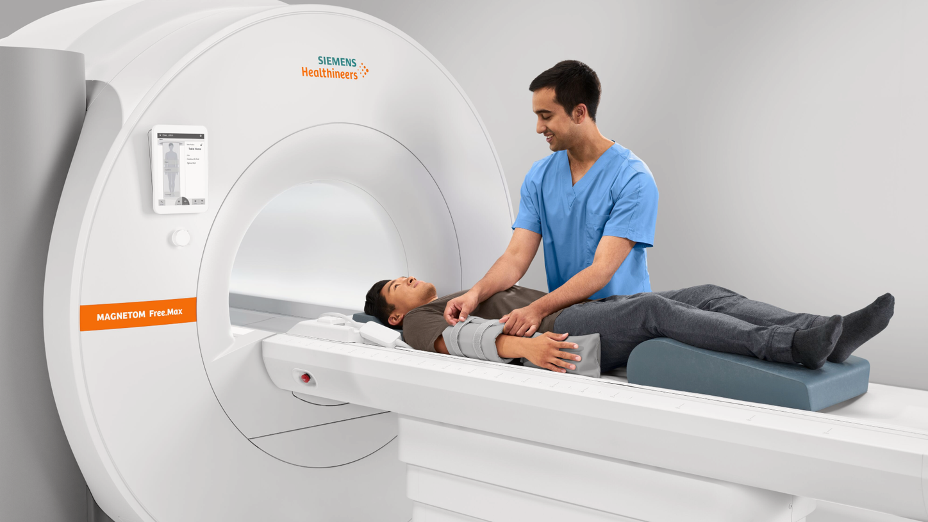
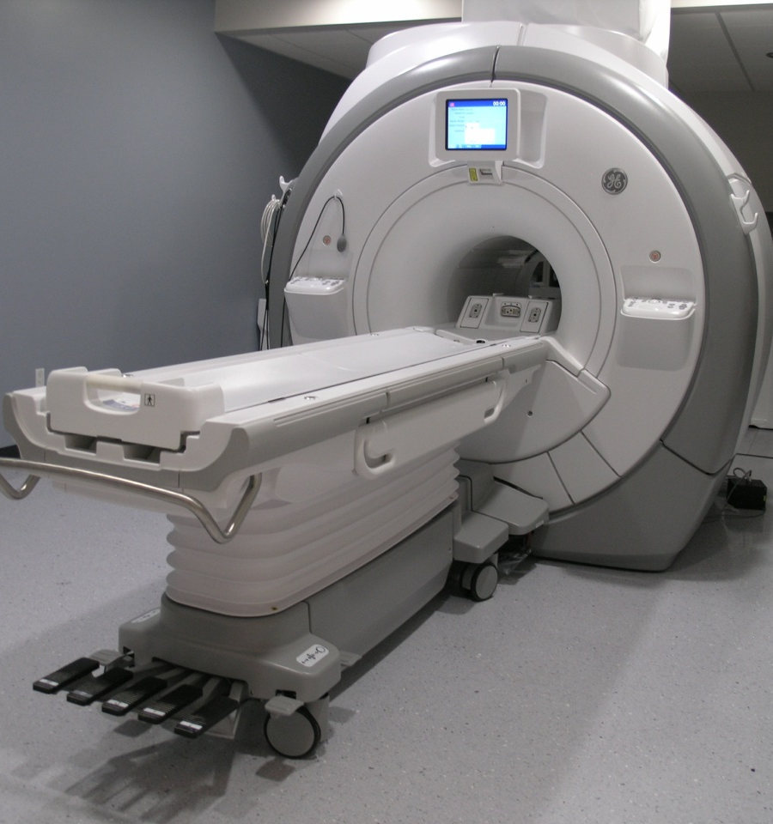
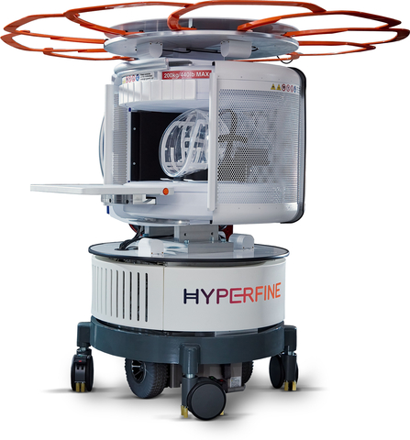
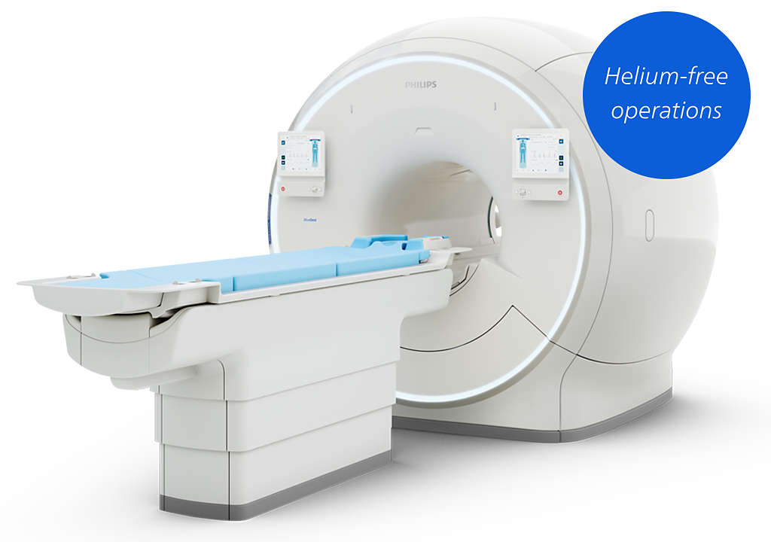
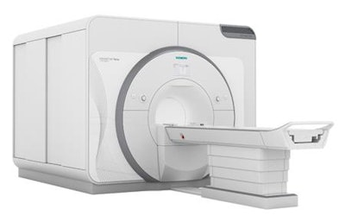
Siemens 0.55T MRI
GE 3T MRI
Hyperfine 0.064T MRI
Siemens 7T MRI
Philips 1.5T

Slide 17
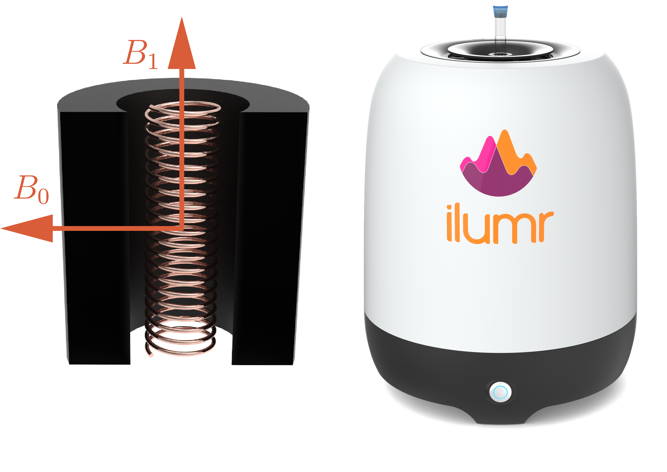
The Tabletop MRI System
0.35 T magnetic field, created with permanent magnets
Can image objects up to about 1x1x1 cm³
Used for teaching and learning MRI
Cheaper and more accessible than regular MRI system

Slide 18
Is MRI safe?
It is safe to be scanned over and over with MRI because it uses no radiation! The radiofrequencies used are similar to those use in WiFi and cell phones.
BUT - Bringing magnetic objects into a MRI scanner room is dangerous, these can get stuck to the large magnet

Slide 19
The MRI Experiment
B₀
Polarization
  Go into a large magnet
  ¹H nuclei, mostly in water, slightly align with the magnetic field
Excitation
  Send radio-frequency wave into the body
  ¹H rotate (resonate) in the magnetic field
Reception
  ¹H rotation creates fluctuating magnetic field
  Changes in magnetic field creates electric currents in RF Coils (antenna)
Imaging
  Slightly vary magnetic field across body using magnetic field gradients
  ¹H in different locations rotate at different frequencies

Slide 20




$$B_{1}^{+}$$
$$B_{1}^{−}$$
$$B_{0}$$
B₀
B₀
B₀
$$\vec{G}⋅\vec{r}$$
Polarization
Go inside a big magnet
Excitation
Send radio waves into the body
Acquisition
Listen for radio waves coming back out of the body
Spatial Encoding
Make small changes to the magnetic field to create an image

Slide 21
Resources
“Magnetic Resonance Explained” - Danish Research Centre for Magnetic Resonance https://www.drcmr.dk/mr
Questions and Answers ​in MRI - MRI Questions & Answers; MR imaging physics & technology – MRIquestions.com
Principles of Magnetic Resonance Imaging by Dwight Nishimura. MRI from a signal processing perspective, Available from lulu.com
MRI: The Basics by Ray H. Hashemi, Christopher J. Lisanti, William Bradley. Understanding MRI with simplified interpretations, with helpful illustrations and image examples.
Handbook of MRI Pulses Sequences by Bernstein, King, Zhou. Essential for advanced MRI work.

